Slide 1
ENGINEERING CHEMISTRY - II
22CH203
Unit 4 – Lesson Plan 2

Slide 2
Homogeneous catalysis
When the reactants and the catalyst are in the same phase (i.e. solid, liquid or gas) it is said to be homogeneous.
Example - Hydrolysis of ester
CH₃CO₂CH_{3(l)} + H₂O_{(aq)} ⇌ CH₃CO₂H_{(aq)} + CH₃OH_{(aq)}
All the reactants and the products are in liquid phase
H⁺

Slide 3
Homogeneous catalysis
The number of collisions between reactants and catalyst is at a maximum because the catalyst is uniformly dispersed throughout the reaction mixture.
Many homogeneous catalysts in industry are transition metal compounds, but recovering these expensive catalysts from solution has been a major challenge.
Many homogeneous catalysts can be used only at relatively low temperatures, and even then they tend to decompose slowly in solution.
High-density polyethylene and polypropylene are produced by homogeneous catalysis.

Slide 4

Homogeneous catalysis
Examples:
Depletion of ozone by chlorine free radicals (all in gas)
Chlorine free radical is from chlorofluorohydrocarbons (CFC)

Slide 5
Homogeneous catalysis
Advantages:
Since the reactants and catalyst are in the same phase, the reactions see a higher rate of catalytic activity with more interaction of the catalyst by the reactants.
These reactions have a higher selectivity in terms of which reactions they catalyse.
These reactions use milder conditions of reaction as compared to usual.

Slide 6
Homogeneous catalysis
Advantages:
Homogeneous catalysts are precisely and easily characterized via spectroscopic methods rather than heterogeneous catalysts in which the reaction takes place with reactants adsorbed on the catalyst surface.
For exothermic reactions, the homogeneous catalyst passes the heat produced in the reaction into the solvent i.e., dump heat into the solvent.
Homogeneous catalysts are easier to characterize precisely, so their reaction mechanisms are widely acceptable.

Slide 7
Homogeneous catalysis
Disadvantages:
The catalyst, being in the same phase as the reactants, is difficult to isolate from the product at the end of the reaction.
There is a limitation associated with homogeneous catalysis in terms of thermal stability. Many homogeneous catalysts are organometallic compounds with a higher chance of getting degraded at temperatures above 100ºC.
After recognizing the limitations of the homogeneous catalytic reaction, there has been an attempt to synthesize a heterogenized homogeneous catalyst, which combines the advantage of homogeneous catalysts of good activity and selectivity with heterogeneous catalysts’ ability to regenerate the catalyst back after the reaction.

Slide 8
Heterogeneous catalysis
The catalytic process in which the reactants and the catalyst are in different phases is known as heterogeneous catalysis.
Example – reactants and products in gas phase while catalyst in solid phase.

Slide 9
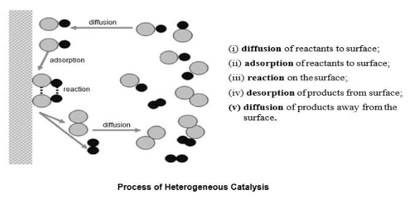
Heterogeneous catalysis
desorption

Slide 10
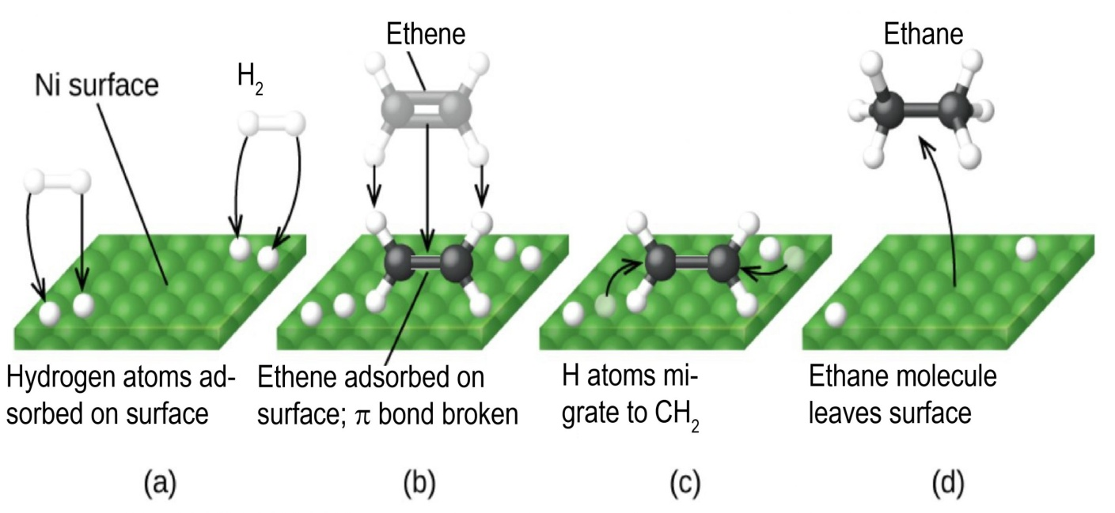
Heterogeneous catalysis
Mechanism – Reaction of ethylene with hydrogen on nickel surface.

Slide 11
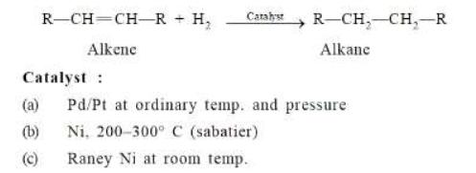
Heterogeneous catalysis
Examples:
Conversion of ethylene to ethane

